Slide 1
SENG3011 – MSM Module
By Group 13 – The Gs
Saishav Agarwal, Yuwei Chen, Rashim Rahman, Hariharen Veerakumar

Slide 2
Requirements
An analysis of data provided by SIRCA to implement the best trades based on historical data
Analysis done using the Momentum Strategy
An appropriate user-friendly GUI for anyone to use the module
Module is flexible in allowing different user inputs

Slide 3
MODULES USED
We have created a module using Ruby, and exported as a native EXEcutable application
Hence, our module is compatible for all Windows platforms – used by the vast majority of end-users
The GUI appliction of the module itself is a Java Applet, allowing cross-platform usage
The GUI application is specific to our module

Slide 4
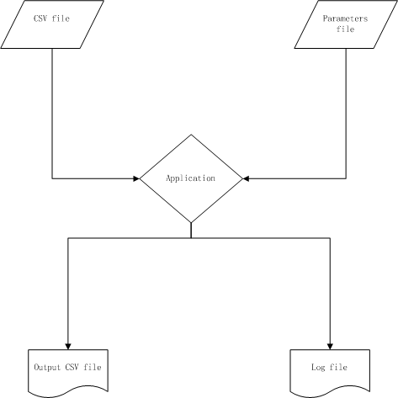
Software Architecture

